Slide 1
Greece
Humanism and the Speculative Leap

Slide 2
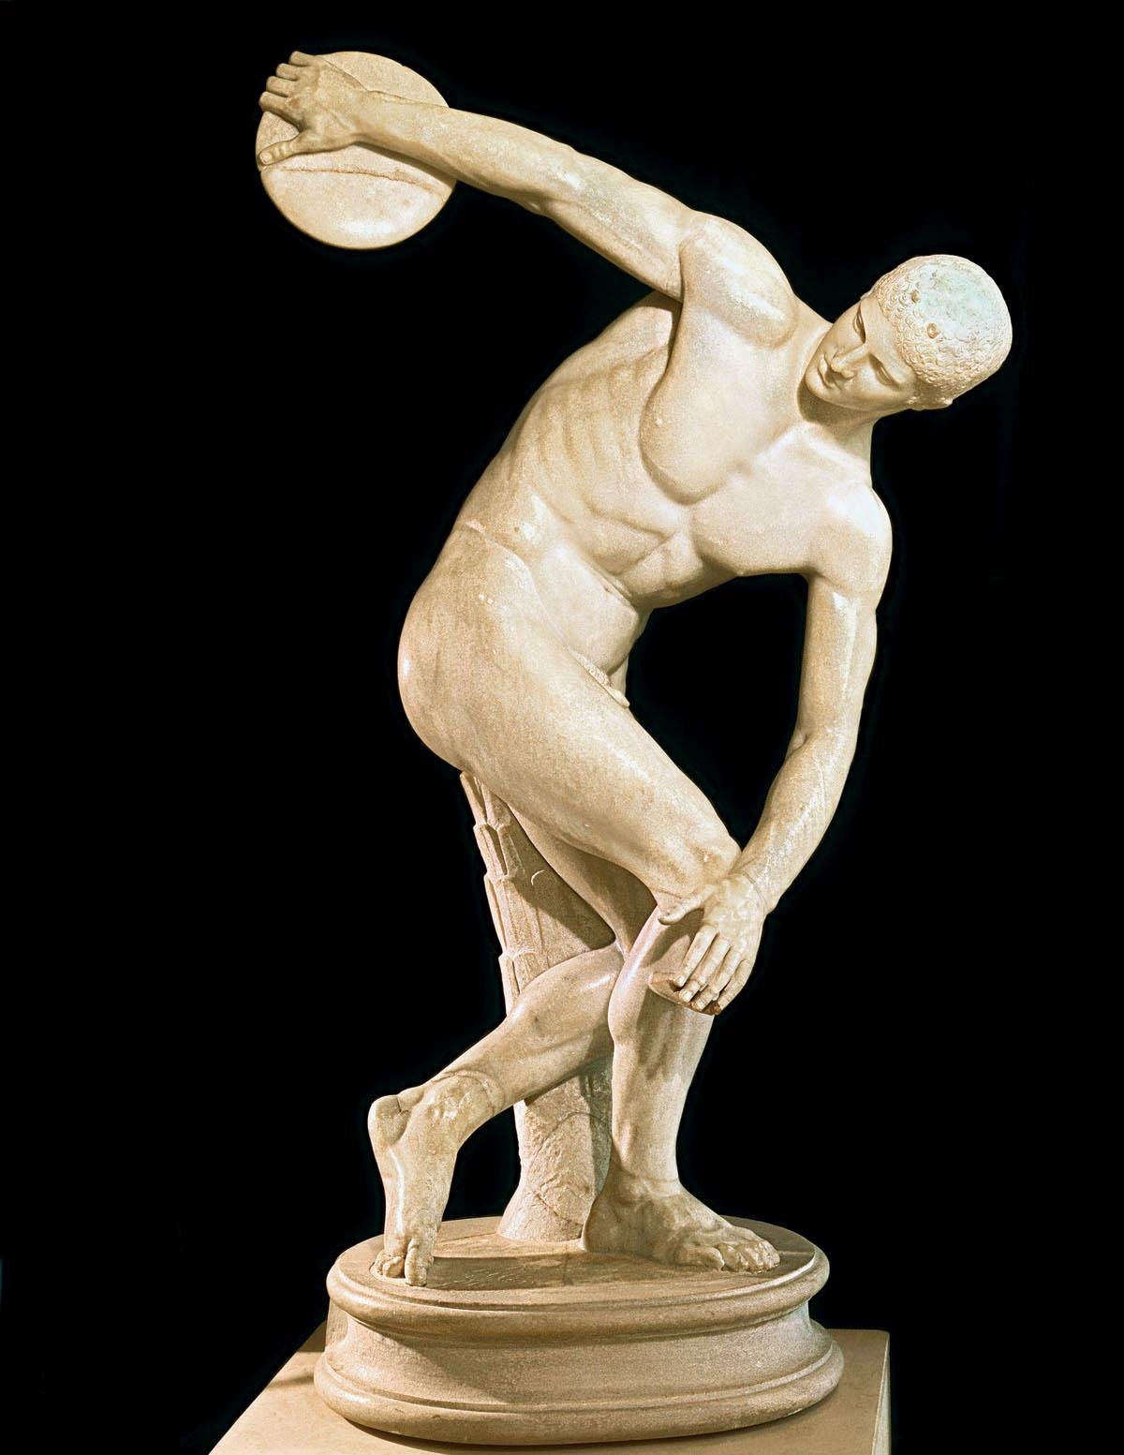
“We are all Greeks.”
-Percy Bysshe Shelley
All to which we owe the Greeks:
The refinement of literary expression including drama, lyric poetry, and historical narrative
The fundamentals of philosophic and scientific inquiry
The formation of a set of aesthetic values in art and music

Slide 3
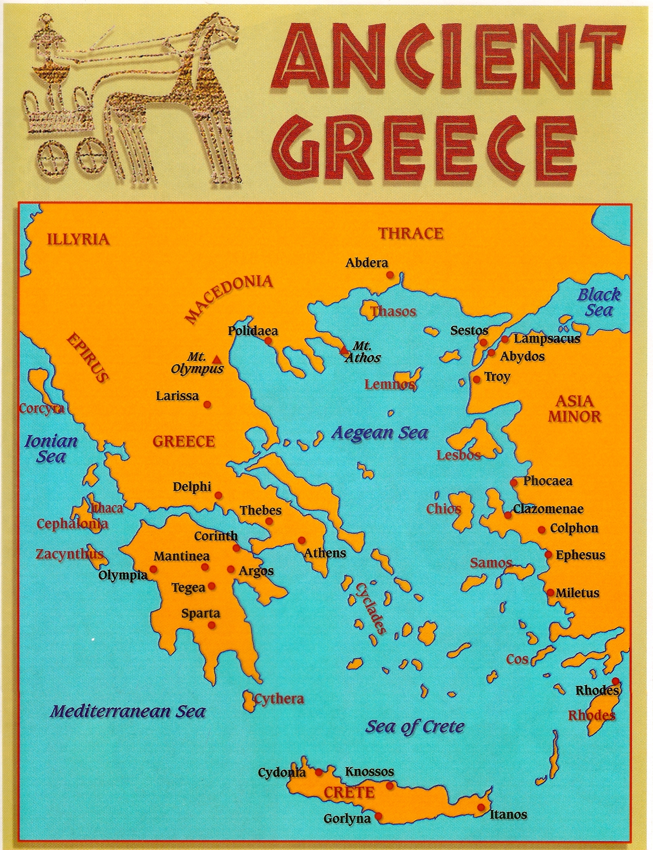

Slide 4
Minoan Civilization 2000-1400 B.C.E.
In the first decade of the twentieth century, the British archeologist Sir Arthur Evans uncovered an even earlier civilization located on the island of Crete. He called it “Minoan” after King Minos, a legendary Greek ruler and his minotaur. The Minoans were lively, pleasure-loving people fond of elegant clothes and new ideas. Their palaces even contained a system of plumbing, unmatched in sanitary nicety until Victorian times.
The Minoan maritime civilization flourishes between 2000 and 1400 B.C.E., when it appears to have been absorbed my the Mycenaean.
Minoan culture was prosperous and seafaring, even with the absence of protective walls, suggesting the Minoans enjoyed a sense of relative security. They were dominated by a warrior aristocracy, as the wealth of their graves attests. One theory is that the Myceneaen people fought as mercenaries for the Egyptians, who paid them in gold.
Minoans contributions to visual art is found in palace frescos (painting done on wet plaster), the most famous found in the three-story palace at Knossos, loosely titled “bull-leaping fresco.”
The Minoans developed a hieroglyphic script by 2000 B.C.E., and a later version found on mainland Greece, appears to be an early form of Greek.
Around 1700 B.C.E., an earthquake brought devastation to Minoan civilization. This natural disaster, along with the invasion of the Aryans and their absorption of the Minoan culture, would lead to what will eventually become the Greek culture. Many of the pantheon of Greek gods come from the Aegean and Minoan cultures.

Slide 5
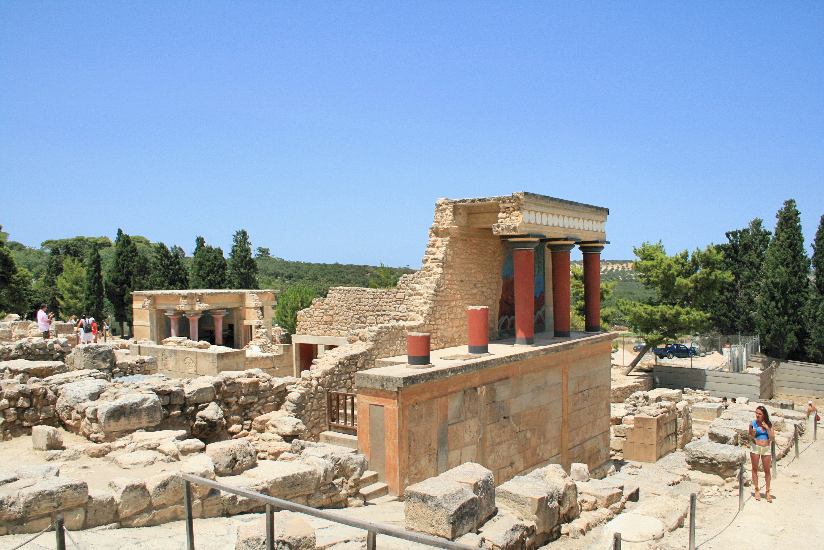
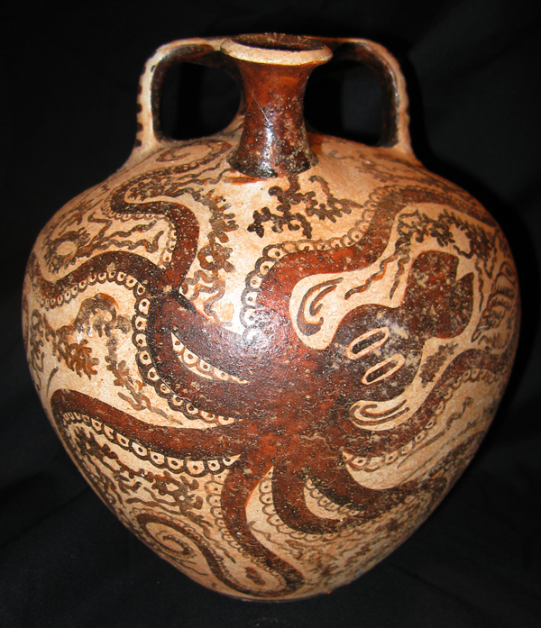
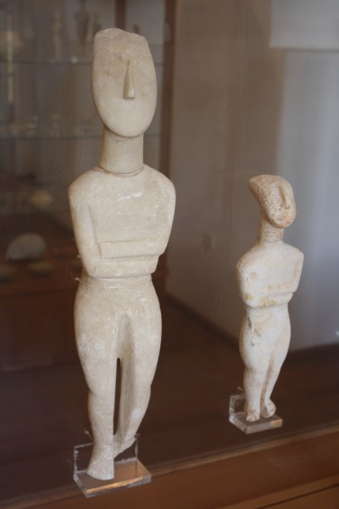
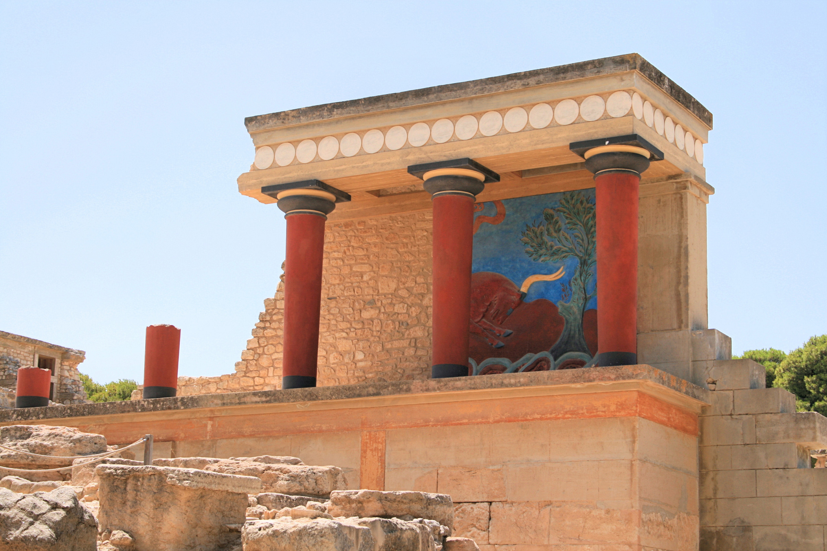
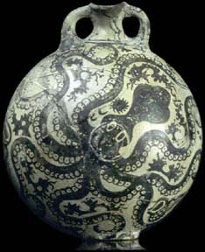

Slide 6
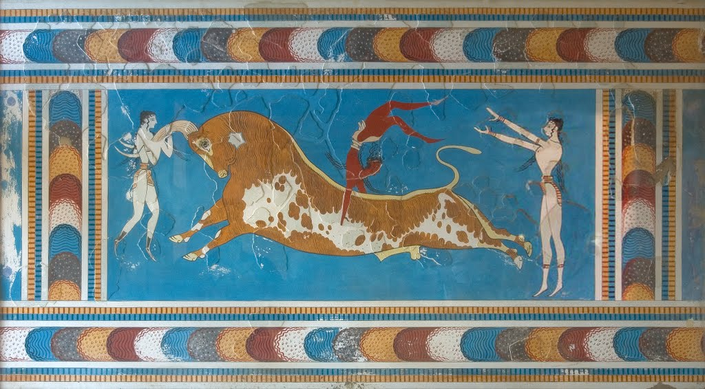
Bull-leaping fresco from the Palace of Minos, Knossos, Crete
Notes:
Shows two women and a man, the man somersaulting over the back of a bull. Most likely associated with the cult of the bull, which is an ancient symbol of virility. This ritual game depicted pre dates the modern bullfight.
Possible connections to rituals of blood sacrifice.
Human beings depicted are not pawns in a game, but as challengers in a contest of wit and physical agility.

Slide 7
Bronze Age Civilizations 3000-1200 B.C.E. The Mycenaean
The Bronze Age culture of Mycenae was unknown to the world until the late nineteenth century, when a German archeologist named Heinrich Schliemann discovered the first artifacts of ancient Troy.
The Mycenaean were a tribal people, militant and aggressive, who established themselves on the Greek mainland around 1600 B.C.E.
The Mycenaean were spectacular builders. Their palaces were built within formidable citadels with walls 10 feet thick, and some of their royal tombs called tholos tombs, were enormous beehive structures made of stones weighing as much as 120 tons. These tholos tombs are believed to be burial places of Mycenaean rulers.
Mycenaean occupations ranged from goldsmiths, masons, bakers, cooks, woodcutters, messengers, , longshoremen, shepherds, dry cleaners, doctors, potters, foresters, carpenters, bowmakers, and weavers.
Around 1200 B.C.E., the Mycenaean attacked Troy, a commercial stronghold on the northwest coast of Asia Minor. This ten-year-long war would provide the historical context for the Iliad and the Odyssey, two great epic poems of the ancient Greeks.

Slide 8
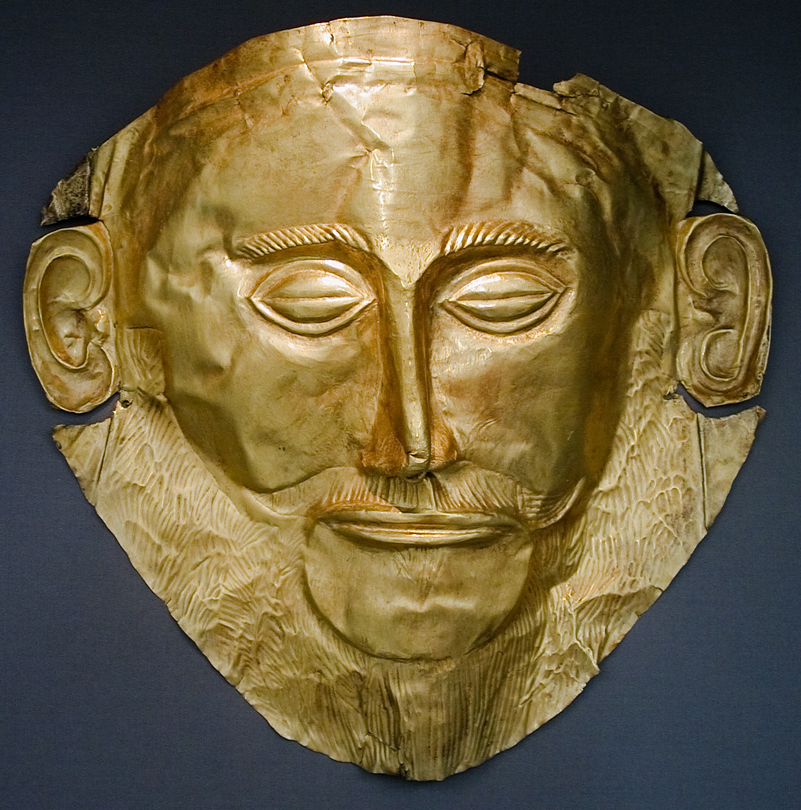
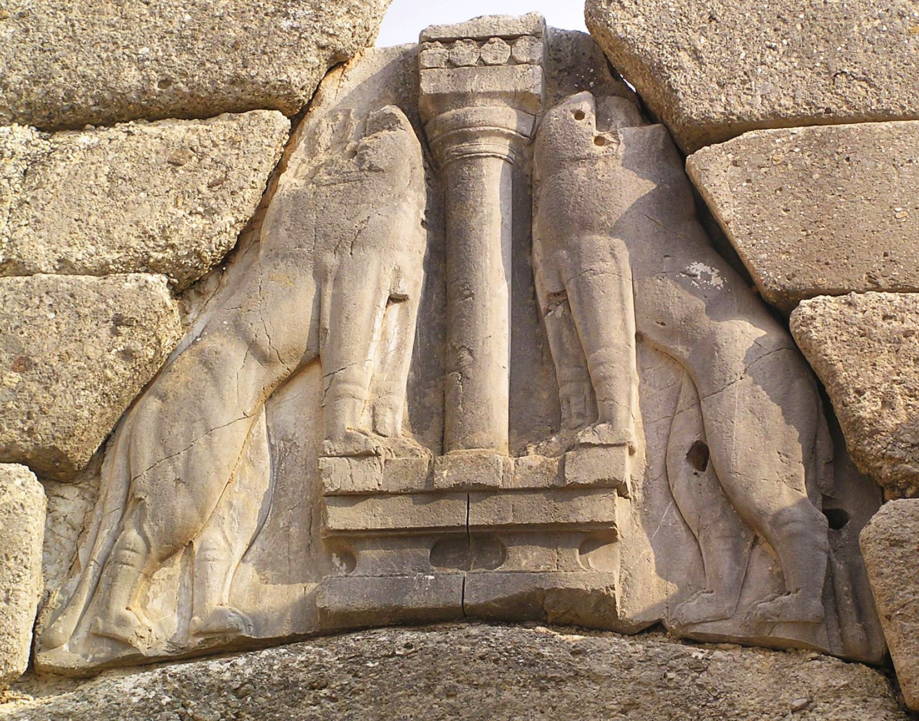
Funerary Mask of Agamemnon
Lion’s Gate, Citadel at Mycenae
Notes:
Agamemnon mask:
Gold
Lion Gate: On mainland Greece, the Mycenaeans constructed this massive wall and others like it, so fortified that later generations thought the structures had been built by a mythical race of giants know as the Cyclops. Nine foot high stone lions flank a column that hold a Minoan-style alter.

Slide 9
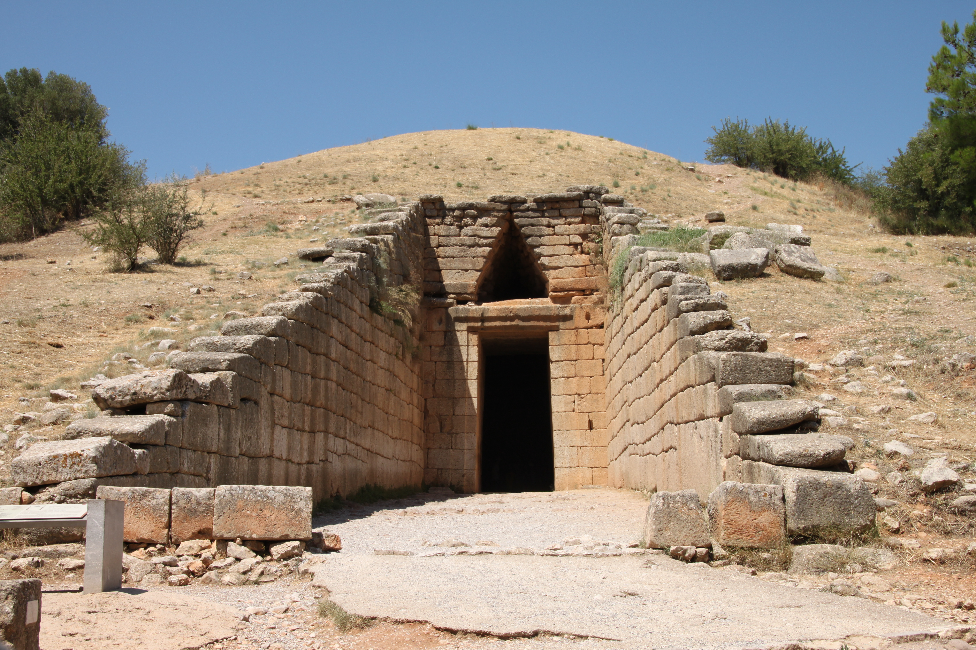
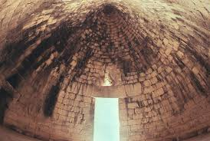
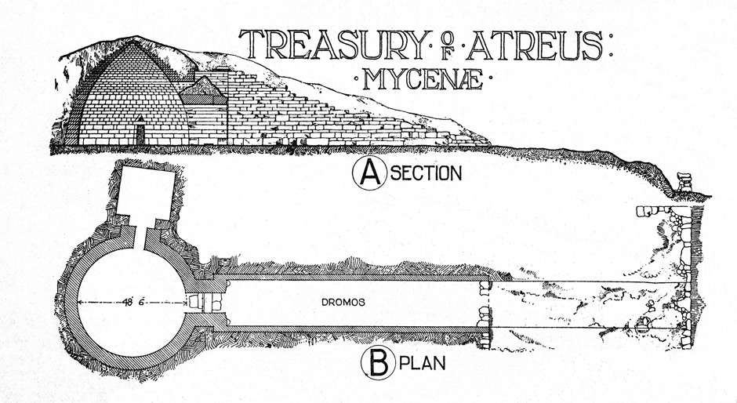

Slide 10
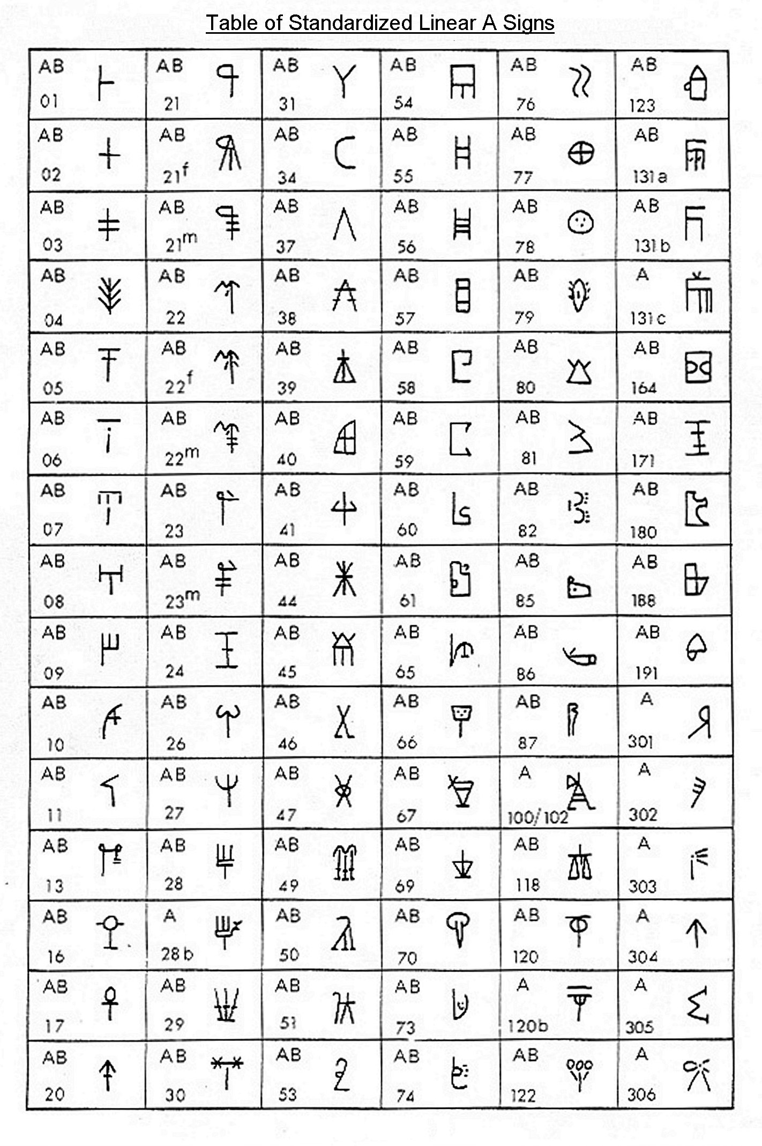
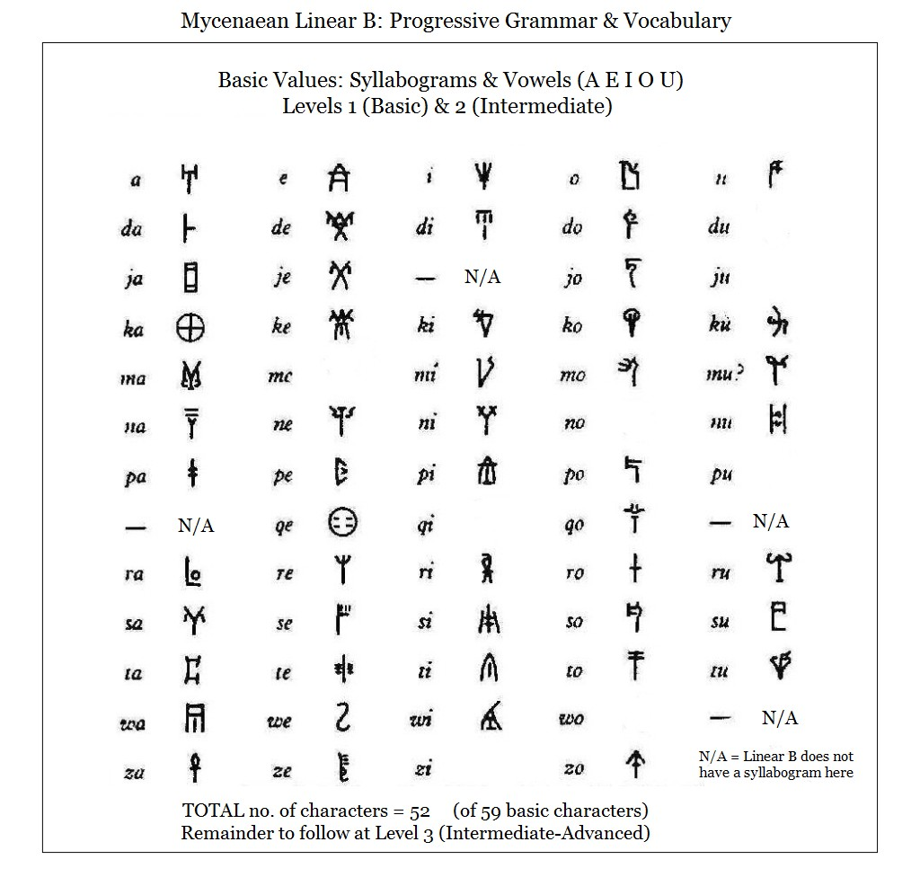
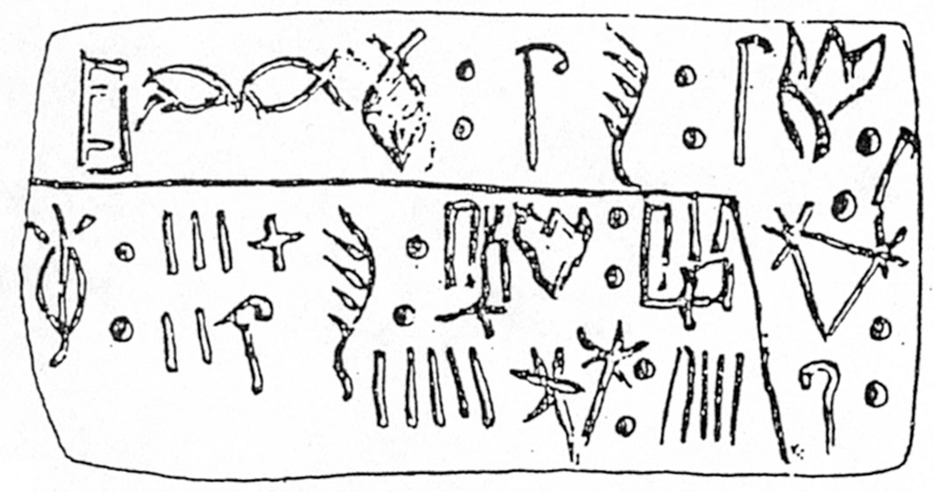
Evolution of Ancient Greek Hieroglyphs
Early Hieroglyphs
Linear A
Linear B
Notes:
Early hieroglyphs nor the Linear A have been deciphered.
Linear B, found on mainland Greece, is an early form of Greek. Used for bureaucratic and administrative purposes. 4600 tablets are inscribed with lists of people, produce, animals, and manufactured goods.

Slide 11
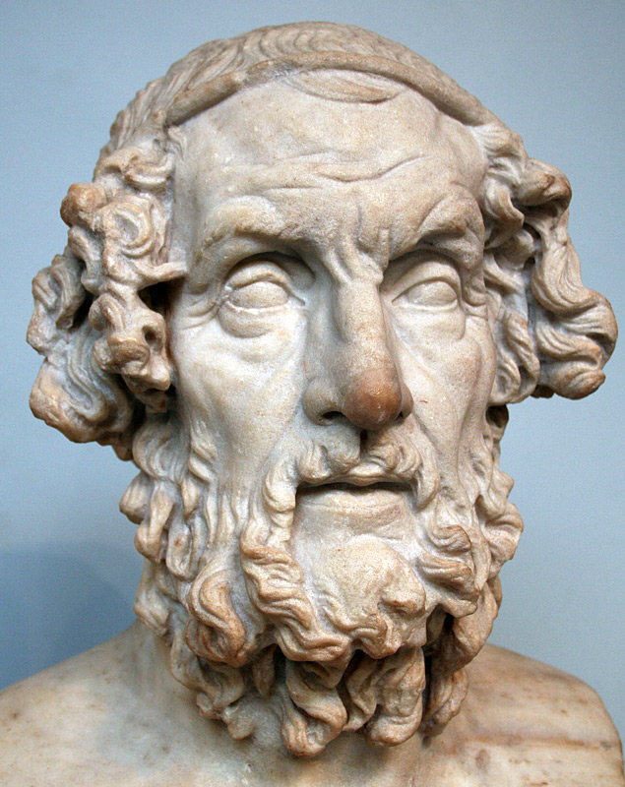
Homer:
Homer’s two great epics rank among the grandest tales, in prose or verse, ever written. He is the first Greek poet- or at least the first that we know anything about.
Both epics are written in hexameters (lines of six metrical feet), and they were committed to memory by every school boy and quoted by most adults. Homer’s epics at this time in Greek history were considered as important to society as the Bible and Shakespeare were to English speakers.
Almost nothing is known of Homer himself. He lived most likely in the mid-8th century, and is said to have been blind. He probably never wrote down anything himself, but the revival of literacy in Greece meant that others did.

Slide 12
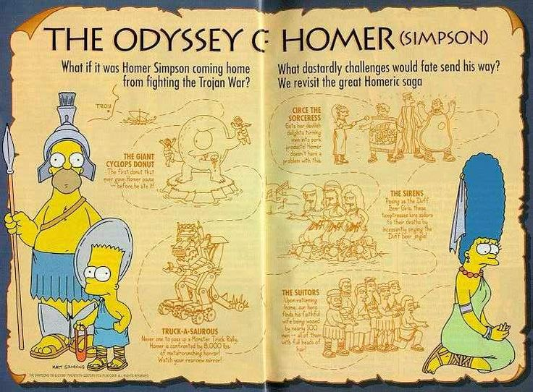
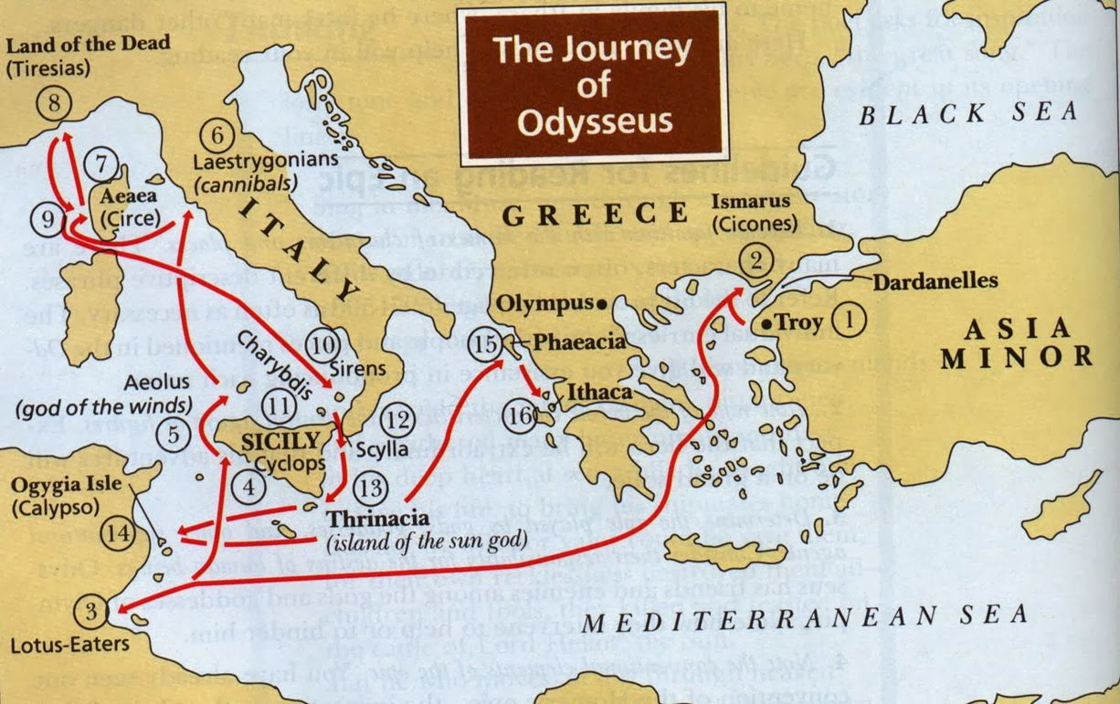
Homer’s Odyssey:
The Odyssey recounts the adventure-filled sea journey taken by Odysseus, a hero of the Trojan War, in an effort to return to his home and family after 20 years, and reassume his authority of the King of Ithaca. Through his wanderings around the limits of the then-known world Odysseus encounters cannibalistic giants, lethal sirens, shipwrecking monsters and finally an enchanting princess.

Slide 13
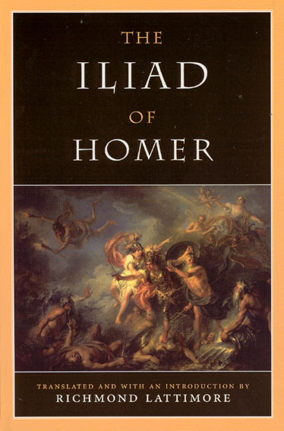
Homer’s Iliad:
Almost 16,000 lines long, the Iliad takes place in the last days of the Trojan War, and is the story of Achilles. Driven to anger over a blow to his honor involving a woman, Achilles refuses to join the battle against Troy. When Patroclus, friend of Achilles, dons his armor of Achilles and is killed by Hector, Achilles joins the battle, and avenges Patroclus’ death by killing Hector and dragging his nude body before the walls of Troy.
Like the epic of Gilgamesh, Achilles is half-god, half-man, but the Greek superhero is more psychologically complex, with the emotions he exhibits-anger, love, rage, and grief-are wholly human. The importance of heroic action in proving virtue, is central to the Iliad, and to the male-dominated culture of the Heroic Age.
The language of the Iliad is charged with heroic vigor. It makes use of vivid similes, graphic epithets, and lengthy catalogues of particulars.

Slide 14
Greek Creation Myth:
In early times, Chaos reigned over a universe without light, a place where endless night and the vastness of death were the only realities. The Eros, (the god of love), sprang forth for reasons unexplained, and with him came light and order.
With the arrival of light came Gaea, the Earth, daughter of Chaos. Gaea gave birth to Uranus, the first king of the universe, and he took his mother Gaea for his wife. They had many children, including the 12 Titans.
Uranus proved a poor father and husband, so his sister/wife Gaea incited her son Cronos to attack his father, which he did, and ultimately usurped his power. Cronos wed his sister Rhea and ruled as the king of the Titans.
Convinced that one of his children who do the same thing to him that he did to his father, Cronos swallowed the first five of his six children. To save the sixth child from this fate, Rhea wrapped a stone in swaddling clothes and fed it to Cronos. Zeus, the sixth child was raised in secret by nymphs for his safety.
Now an adult, Zeus disguised himself, returned to Cronos’s domain and tricked him with a poisoned drink. As he choked on Zeus’s potion, Cronos coughed up the first five children he swallowed, and Zeus reclaimed the lives of his sisters; Hestia, Demeter, and Hera, and his brothers; Pluto and Poseidon.
There followed a fierce battle against Cronos and the Titians, where Zeus overthrew this father. Zeus cast lots with his brothers, making Pluto the god of the underworld, and Poseidon the god of the sea, while he ruled over heaven and earth. Zeus, an amorous monarch reigned at Mount Olympus as king of all gods.

Slide 15
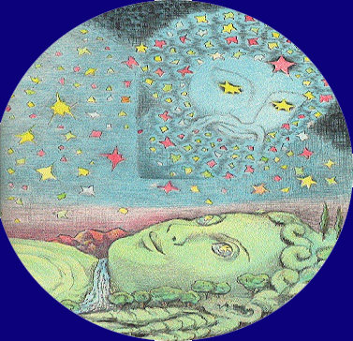
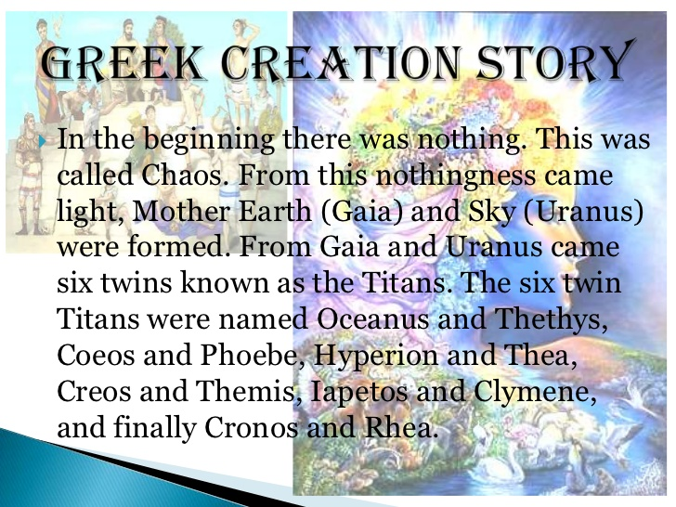
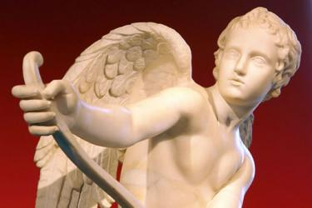

Slide 16
The Greek Gods
The ancient Greeks envisioned their gods as a family of immortals who intervened in the lives of human beings.
In the Theogony (The Birth of the Gods), a poem recounting the history and genealogy of the gods, Hesiod, a contemporary of Homer’s, describes the origins of the universe.
Although immortal, the Greek gods were much like the human beings who worshipped them. They maintained the same traits, many of them “un-god” like. The gods lived atop a mountain in Greece, among their followers, as opposed to a far away heaven.
The Greek gods were not always just- they engaged in combat, seduced mortal women, and meddled in human lives at will. Unlike the Hebrew god, the Greek gods had no clear principals of moral conduct and no guidelines for religious worship.

Slide 17
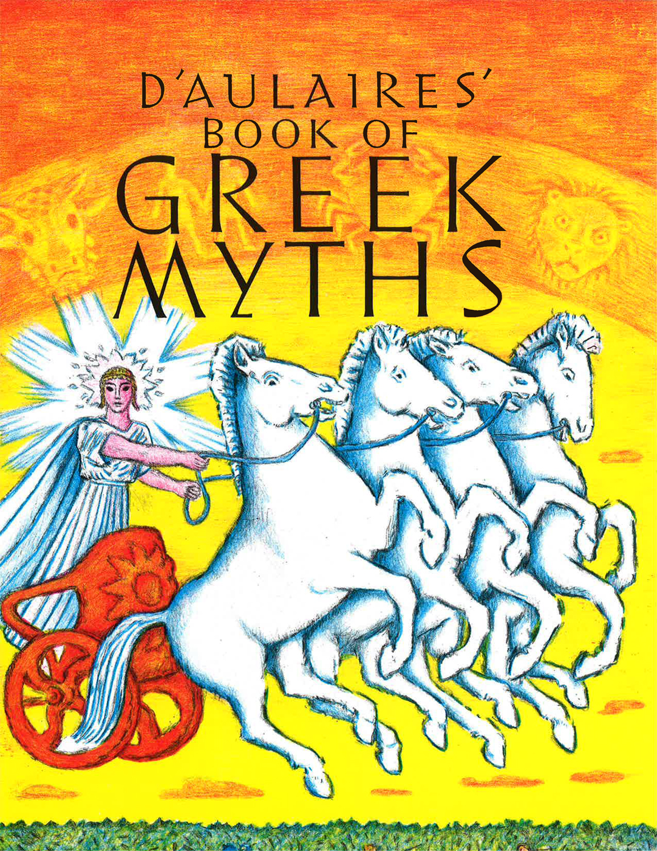
Greek Mythology
The most influential mythology of western civilization comes from the Greeks, standing out for its rich, yet disciplined imagination; for its humane quality, and for its aesthetic nature.
Greek history and mythology has been a fertile source of ideas for dramatists, artists, and philosophers since their inception. Can you name modern artistic endeavors based on Greek mythology?
Greek myths were created to entertain; to release the tensions of human fallibility, to explain natural phenomenon, and to crystalize religious views.
Throughout Greek mythology there runs a consistent view of the world as dominated by gods who were like human beings with the exception of being more powerful and undying. Essentially, gods were favorable to men, especially to the great heroes.

Slide 18
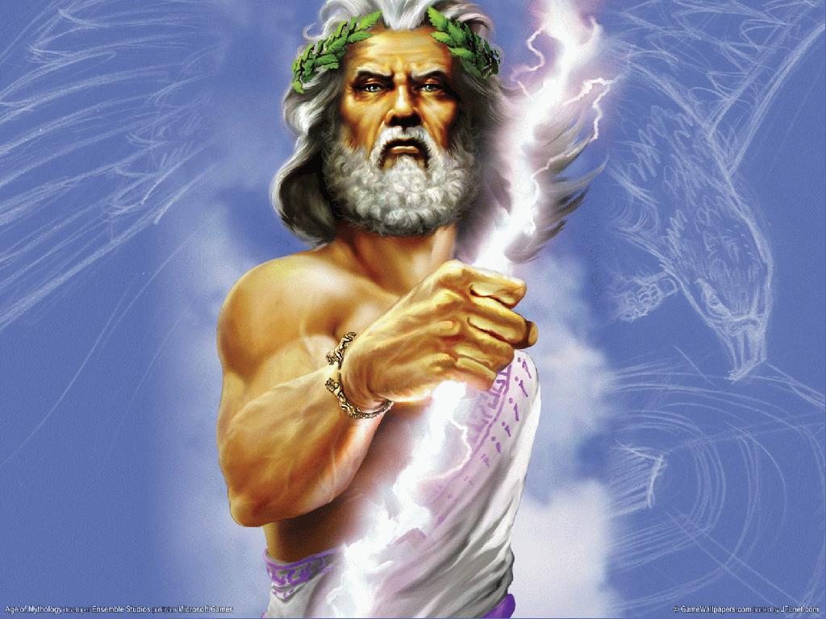
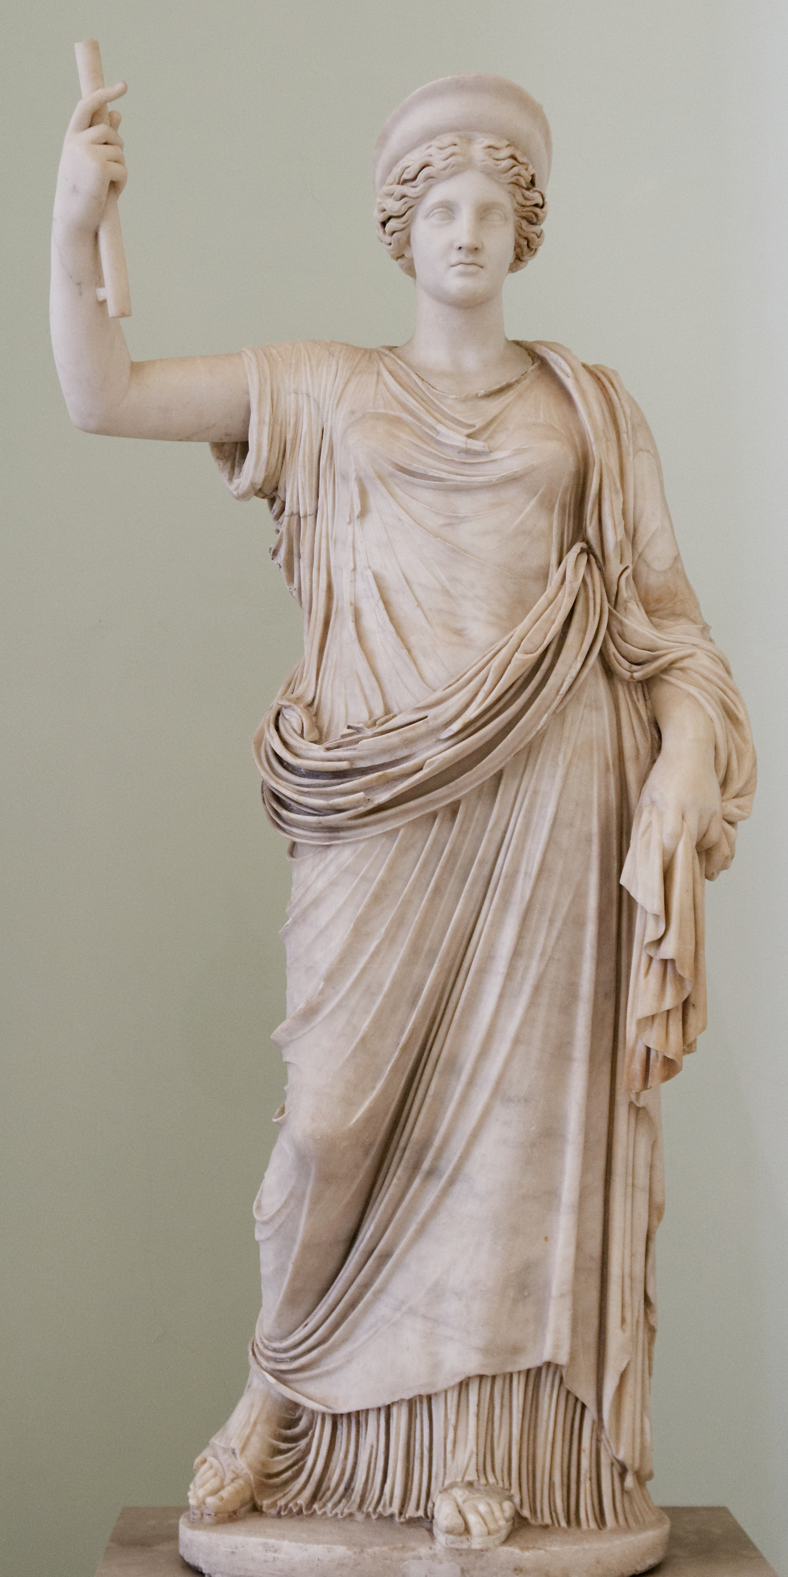
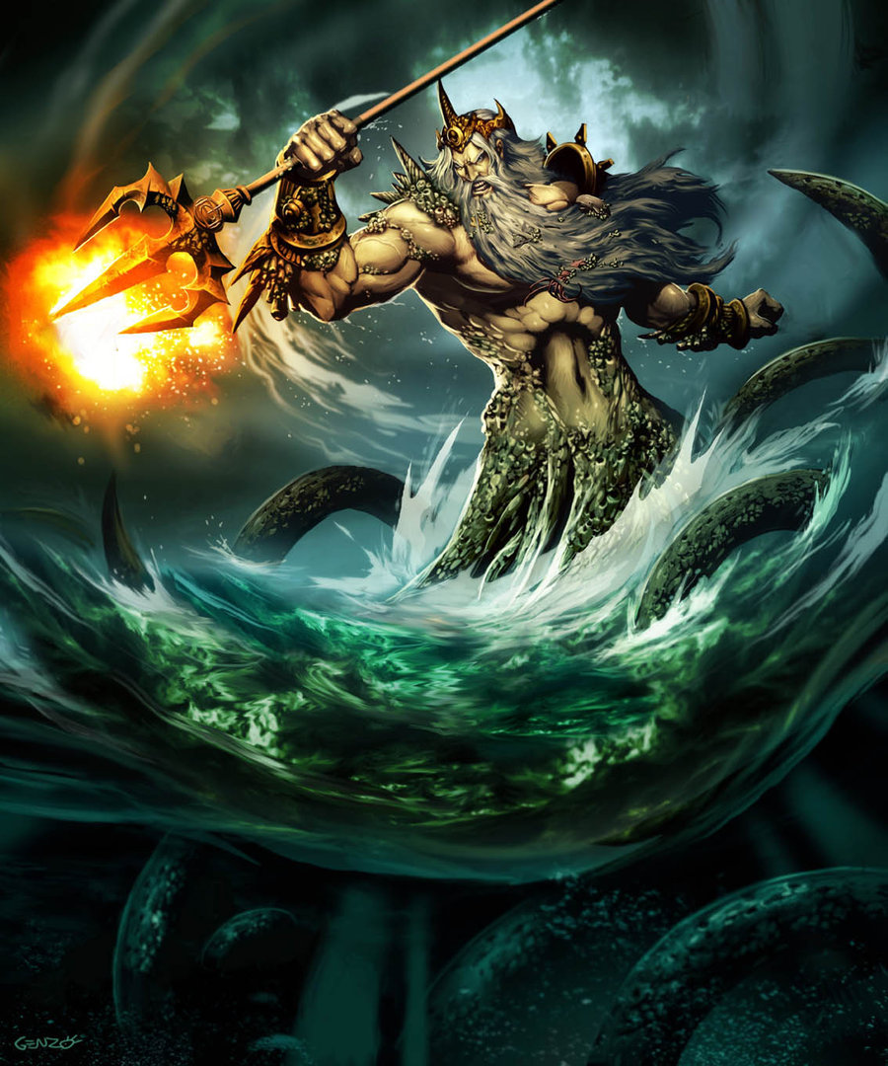
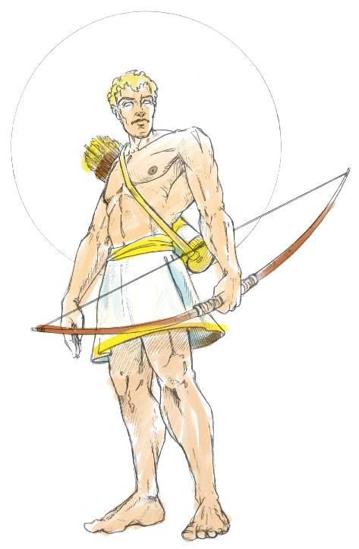
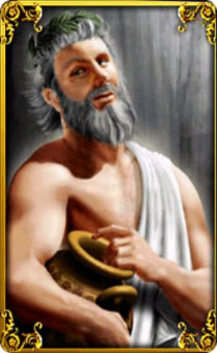
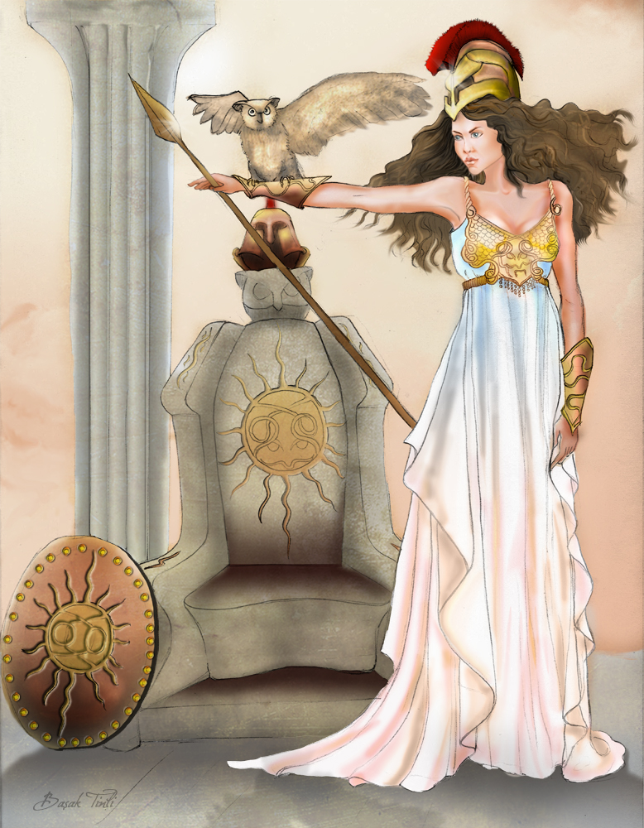
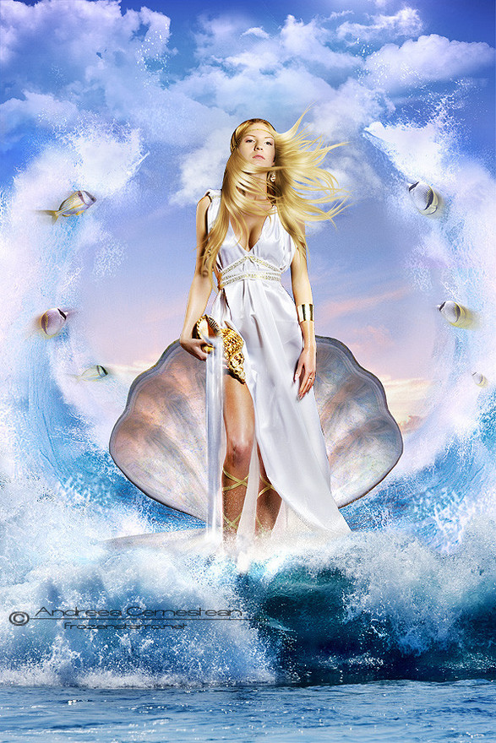
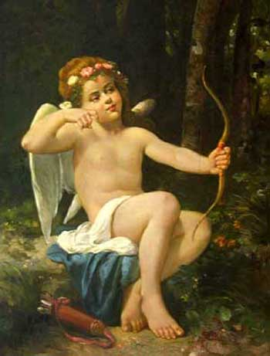
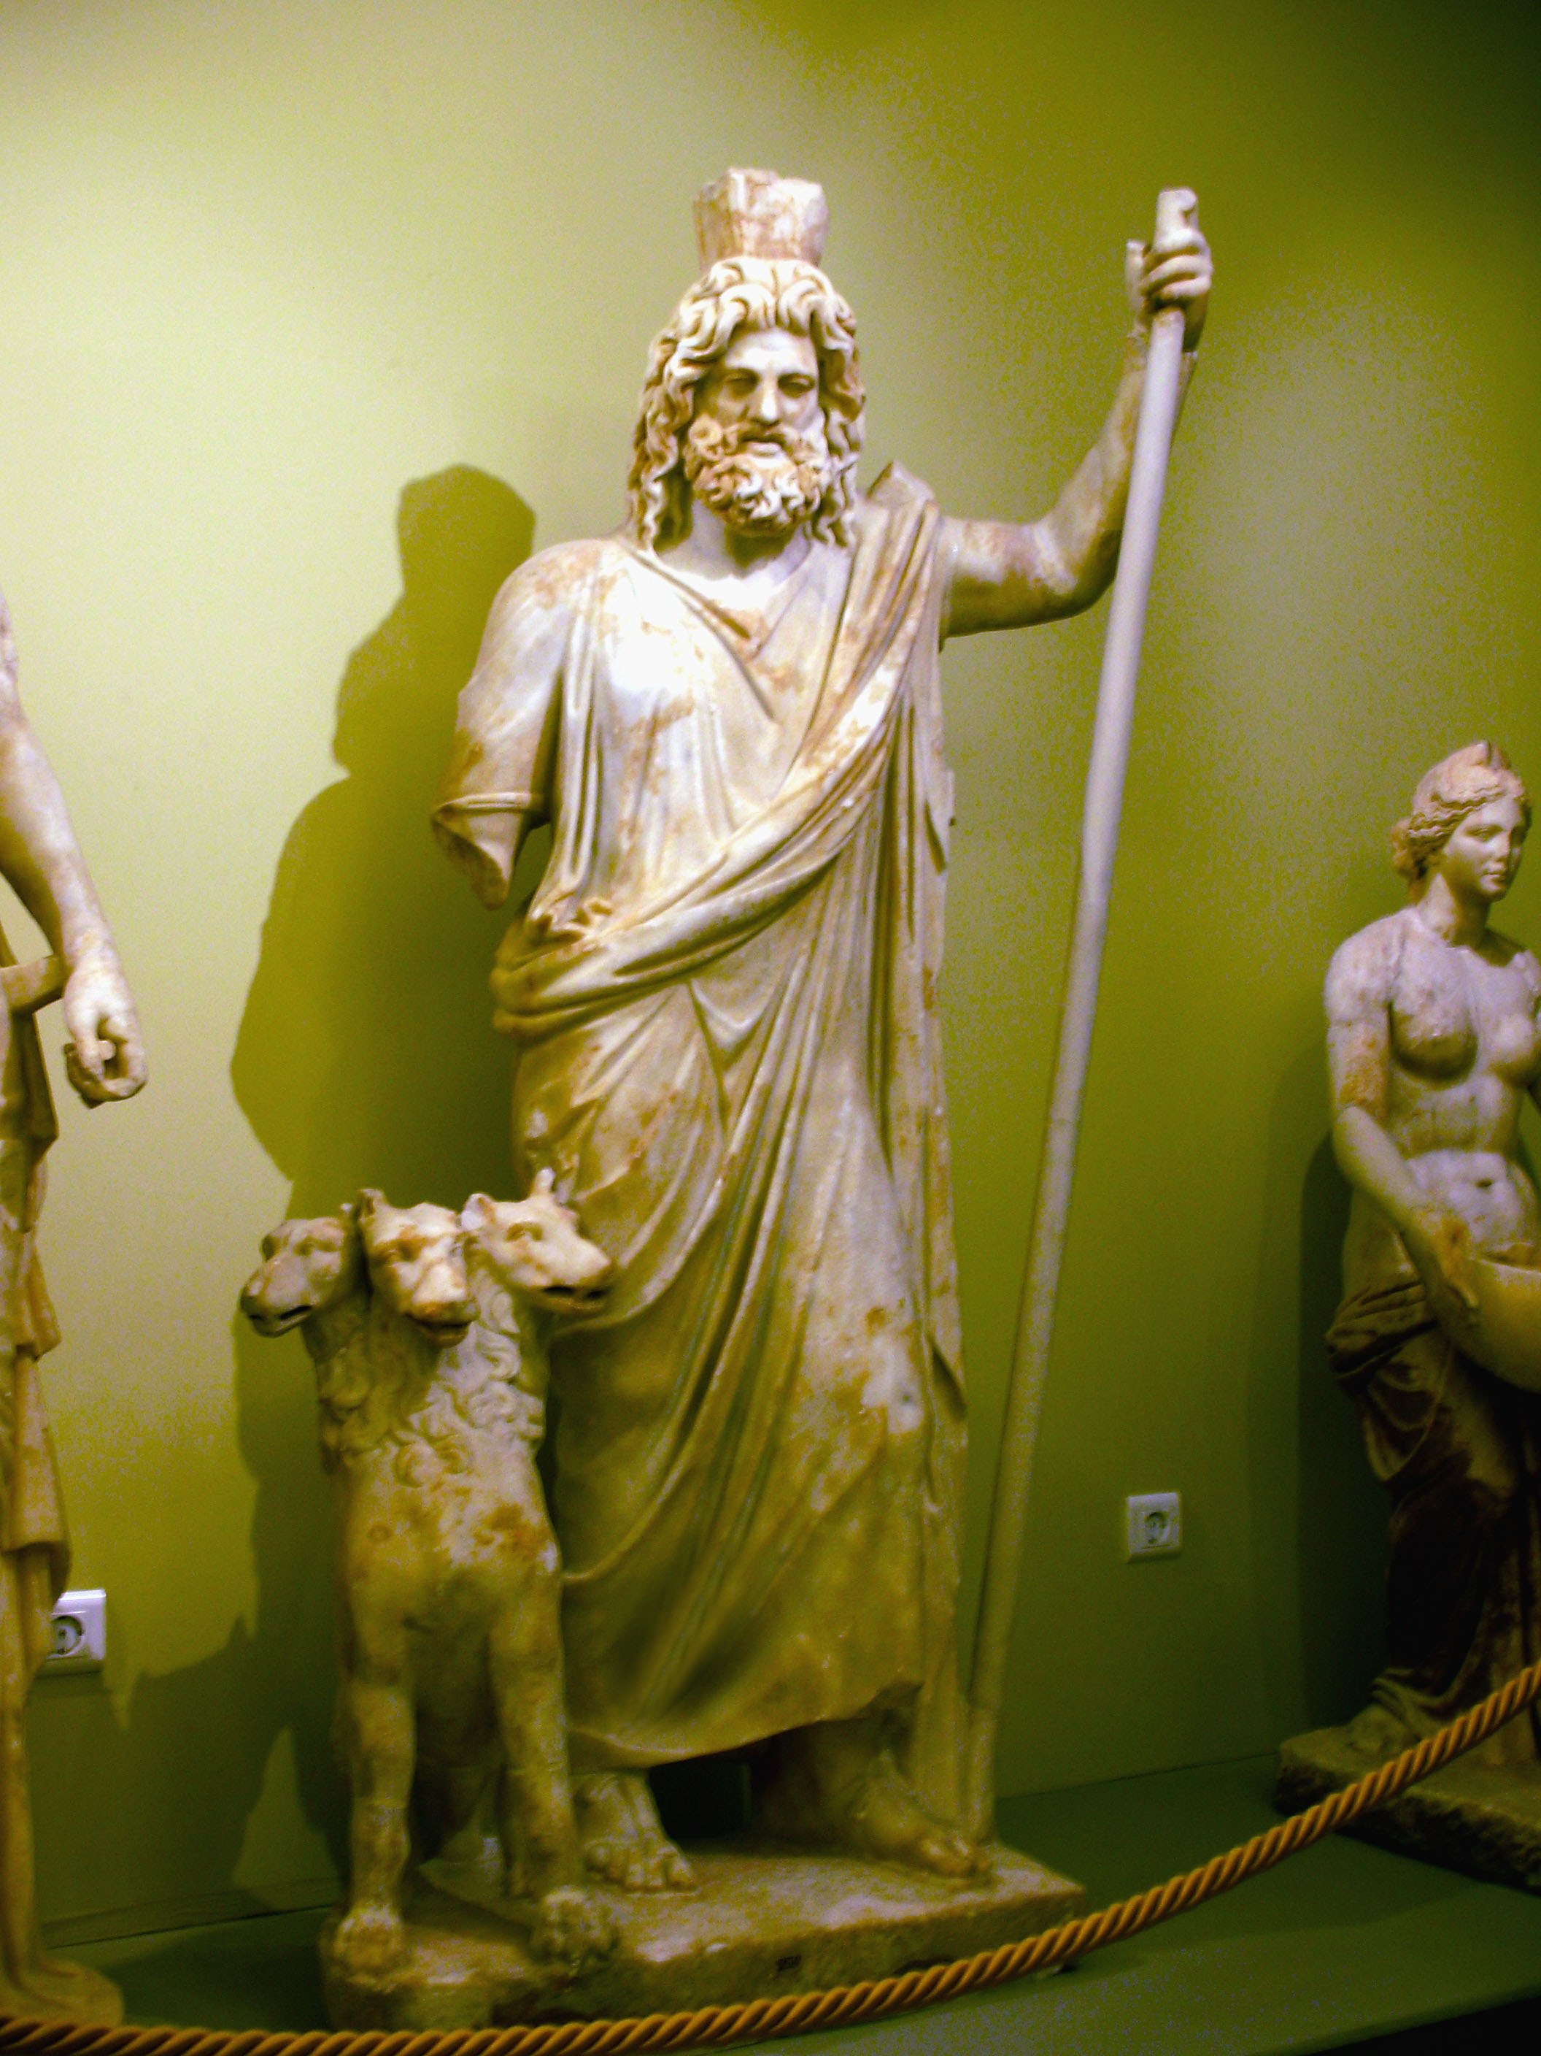

Slide 19
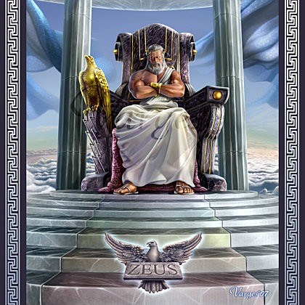
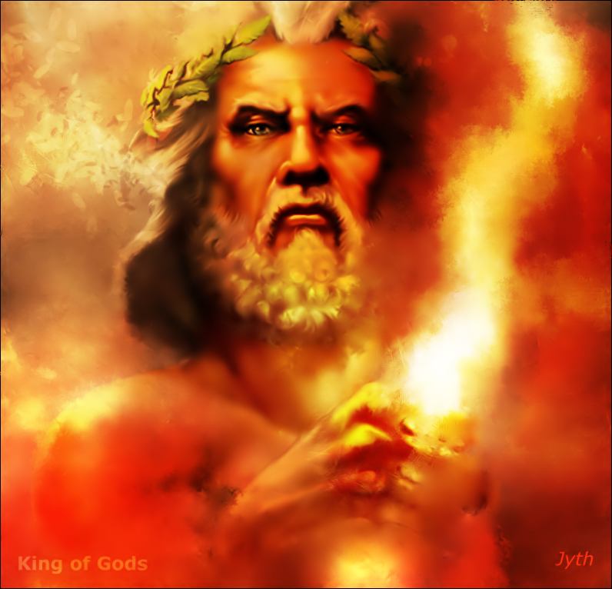
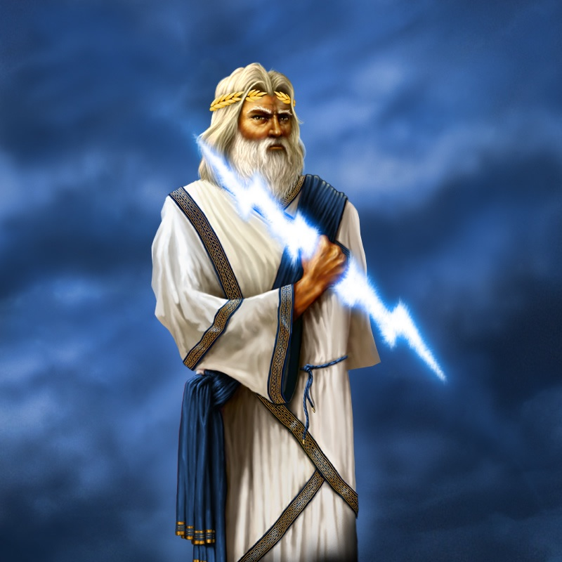

Slide 20
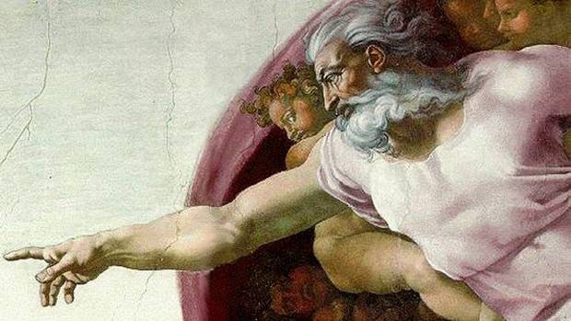
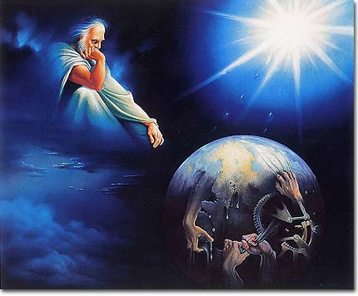
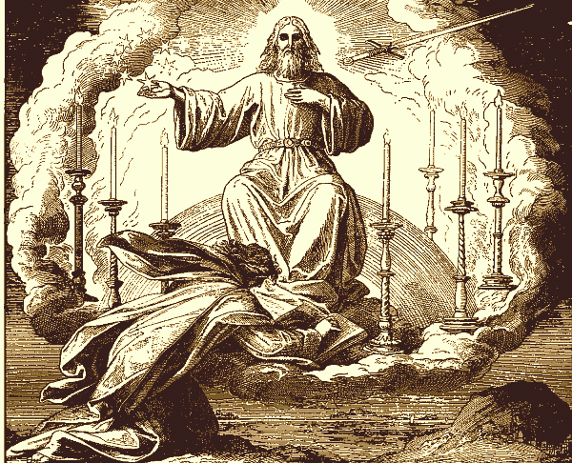
God
Images

Slide 21
Zeus: The ruler of Mount Olympus, king of gods and men, the sixth child of Cronos and his wife Rhea. With the help of his mother, who hid him, Zeus stopped his father’s evil practice of eating his children and then tricked him into eating a stone thinking it was another child. Cronos then coughed up his other sons and doughters and usurped power.
Hera: Zeus’ wife and sister, and protectress of marriage, children and the home. Some tales say Zeus courted her for 300 years before she would marry him. She wanders through the stories of the gods, torturing the other women that Zeus loved.
Apollo: The god of sun and the patron of truth, archery, music and medicine. This son of Zeus is known for the basic Greek precepts, “Know thyself” and “Nothing in excess.”
Poseidon: God of the sea and earthquakes. Homer is to have written that Poseidon built of gleaming gold in the Aegean Sea. Greeks pray to Poseidon to be kindly in heart and help to those who voyage in ships.
Dionysus: God of wine and fertility, he was Zeus’ son by a mortal mother. Hera destroyed Dionysus’ mother and drove him mad, leaving him to wander the earth accompanied by satyrs and nymphs. A symbol of revelry, he gave Greece the gift of wine-at times man’s blessing, at others his ruin.
Athena: Goddess of wisdom and patron of war, she sprang fully formed from the forehead of Zeus. Her gift of the olive tree to mankind won her the devotion of Athens.
Aphrodite: The goddess of love and beauty, wherever she walked flowers sprang up, as sparrows and doves flew about her. She had the power to beguile even wise gods and often placed temptation in the path of Zeus.

Slide 22
The Greek City-State and Persian Wars 750-480 B.C.E.
Greek geography (see slide #3) encouraged the evolution of the Greek city-state or polis. Ancient Greece consisted of some 200 city-states, a few as large as 400 square miles and others as tine as 2 square miles. You could walk around the walls of Athens in only 2 hours!!!
The city-state, in simplest terms, was a small but sovereign political unit, in which all important activity was conducted at one spot and in which communal bonds-expressed in terms of the law- were more basic than personal ties. In all these respects the polis grew out of the political organization of the dark ages.
Greek city-states shared the same language, traditions, and religion, and each polis governed itself, issued it’s own coinage, and provided it’s own military defenses. When confronted by the rising powers of Persia, the Greek city-states united.
By the sixth century B.C.E., the Persian Empire had conquered most of the areas between the western frontier of India and Asia Minor. By 499 B.C.E., mainland Greece was threatened, and in 490 B.C.E., a Greek force of 11,000 men met a Persian army with twice the numbers, and defeated them, losing only 192 men. After building a fleet of warships to continue besting the Persians in battle, the Greeks ultimately defeated the Persian armada at Salamis in 480 B.C.E. With the defeat of the Persians a new era was ushered in of prosperity and self-confidence. In Athens, democracy took root, literature flourished, and the study of history and philosophy became established. Why was this defeat of the Persians so important?

Slide 23
Athens and the Greek Golden Age 480-430 B.C.E.
In the wake of the Persian Wars, Athens assumed political control among the city-states, as well as commercial supremacy in the Aegean Sea.
The spirit of confidence that exuded from the Greeks after overtaking the Persians, ushered in an age of drama, music, art, and architecture. This period between 480-430 B.C.E., was known as the Greek Golden Age, and was one of the most creative in he history of the world.
Athens, the most cosmopolitan of the city-states-was initially an oligarchy, or a government controlled by an elite minority, however, by roughly 600-500 B.C.E., enlightened rulers were putting increased authority into the hands of it’s citizens.
By 508 B.C.E., the citizens of Athens (Popular Assembly of Citizens) and the state aristocrats (The Council of Five Hundred) were operating in tandem creating the first direct democracy in world history. In the most precise and literal sense of the word, the Athenians governed themselves, and in this process the people stripped the aristocrats of their power except for certain judicial functions in matters of homicide and certain religious duties.
The Athenian Assembly was open to all free male citizens of adult age, regardless of income or class. Any member of the Assembly could speak about anything, providing he could command an audience, and every citizen spoke for himself. Such a system of government can only exist when a population is small and intensely civic-minded, and Athens met both of these conditions. One more reason contributed to the strength of Athens’ democracy…

Slide 24
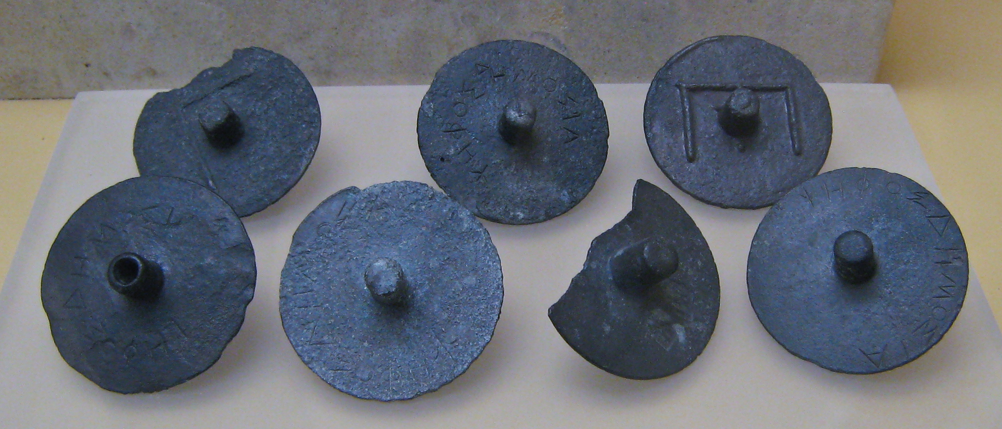
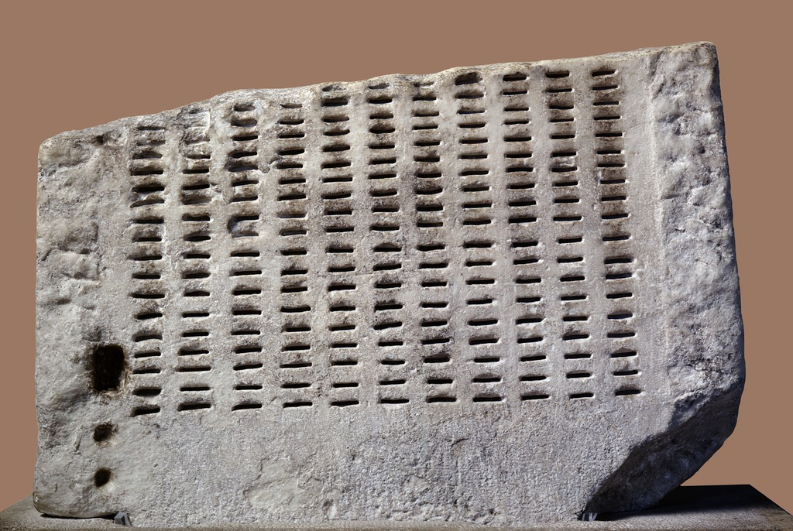
The final reason democracy worked in Athens, was ironically, slavery. With slaves to handle the domestic chores and routine work of commerce and manufacturing, Athenians were free to give their time to public affairs.
These slaves had no political rights, but their lot in general was no worse, and sometimes better than that of slaves in other parts of the world.

Slide 25
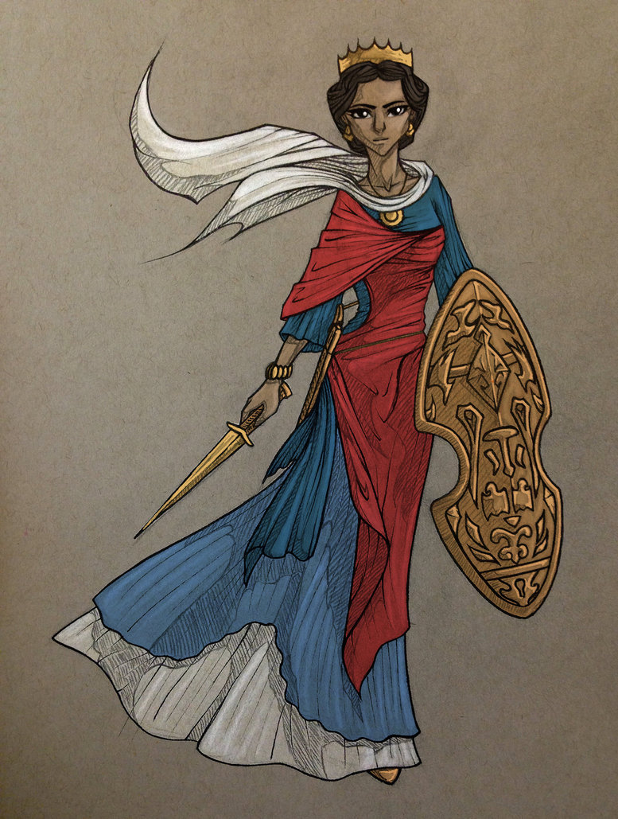
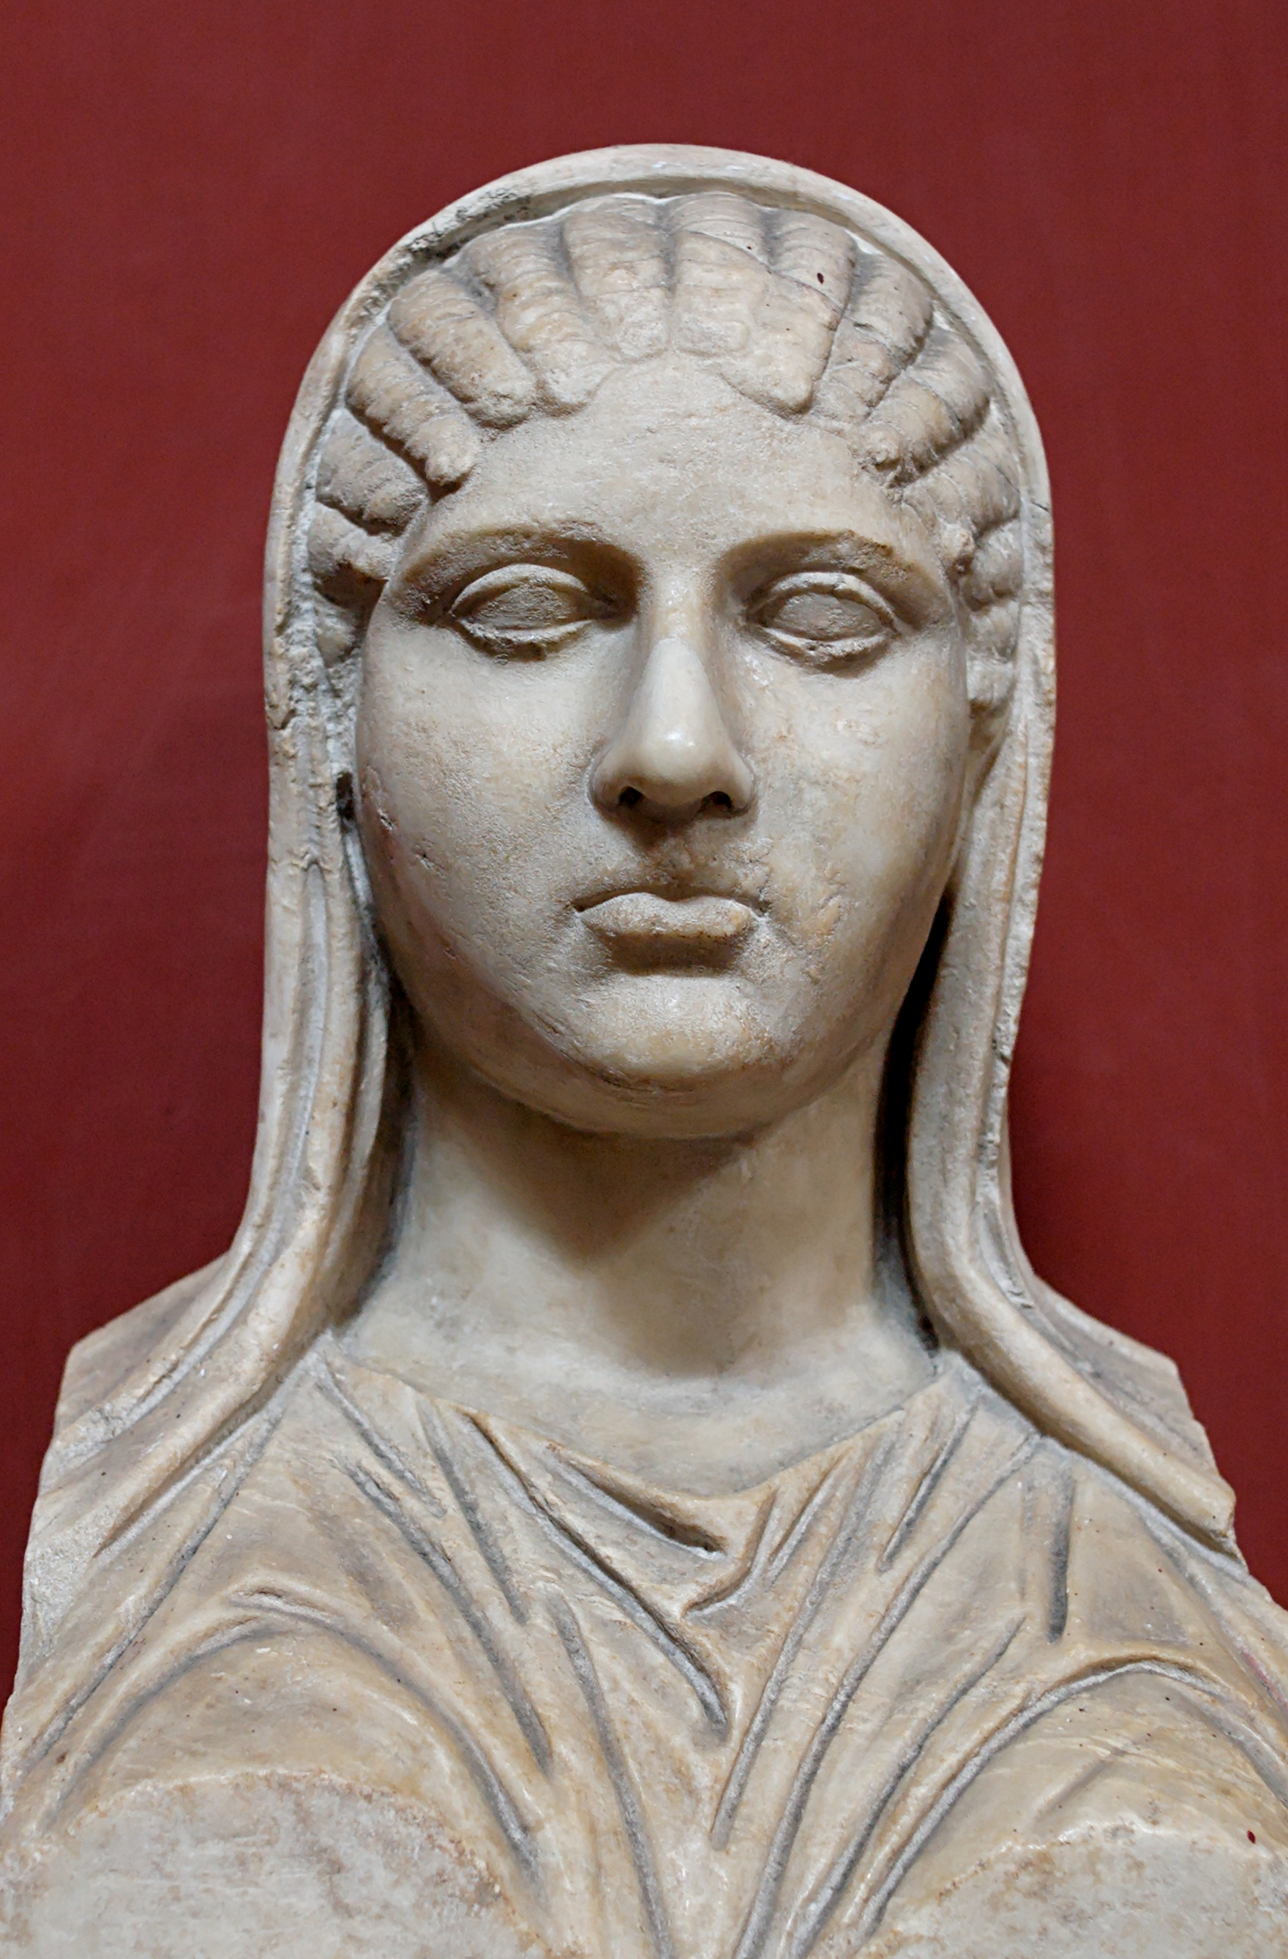
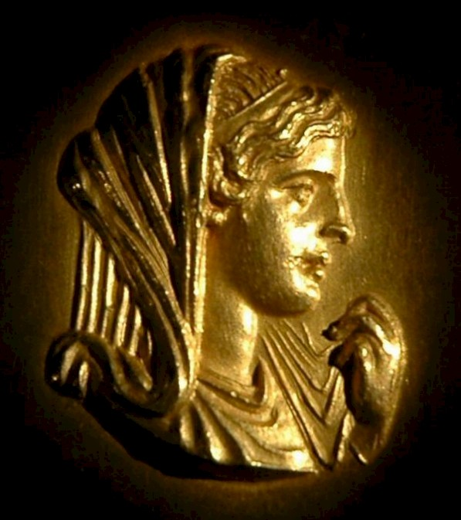
Exceptional Greek Women:
Artemisia was known as the fighting queen. Widowed young, she stepped into her husband’s royal shoes and ruled her city, even after her son came of age. She supplied five ships to the Persian fleet in 480 B.C.E., and prior to the battle of Salamis, she alone advised against the attack. She was ignored and the Persian were defeated.
Aspasia, originally from Miletus, migrated west to Athens in search of fortune. She became the well-known mistress of Pericles, remaining his lover and companion until his death. Highly intelligent, Aspasia was one of few women included in discussions with some of the greatest (male) minds in philosophy. She bore Pericles a son, who although he was born out of wedlock, was letigitimized and made a Athenian citizen, which was a rare honor.
Olympias was married to Philip of Macedonia (most likely for political reasons), and gave birth to their son, Alexander soon after. The marriage was unhappy due to Philip’s infidelities, and the tempestuous Olympias turned to religion. She took part in Bacchic rituals, kept a sacred snake in her bed, sacrificed thousands of animals, and even tried to convince her son that he was born from a god, and not his father Philip. She eventually kills her husband King Philip, and although Macedonian soldiers would not kill her due to her royal rank, relatives of her victims eventually carried out the deed.

Slide 26
Greek Drama
Greek drama consisted of plays that addressed the relationship between the individual, the community, and the gods, and these performances occurred in Athens twice annually.
The literary genre of drama, which tells a story through the imitation of action, grew out of a complex rituals associated with the worship of Dionysus, the god of wine and vegetation.
Greek drama eventually assumed two principal forms: tragedy and comedy. Though still the subject of speculation, tragedy probably evolved from fertility rituals surrounding the death and decay of crops, while comedy seems to have developed out of village revels celebrating seasonal rebirth.
By the fifth century B.C.E., Greece had become a mecca for theater, and while hundreds of plays were performed during the century in which Athenian theater flourished, only forty-four plays survived. They are the products of only four playwrights: Aeschylus, Sophocles, Euripides, and Aristophanes.
The tragedies of Aeschylus, Sophocles, and Euripides deal with human conflicts as revealed in Greek history, myth, and legend, with dramatic action progressed from a specific moment of friction between the individual and fate, the gods, or the community.

Slide 27
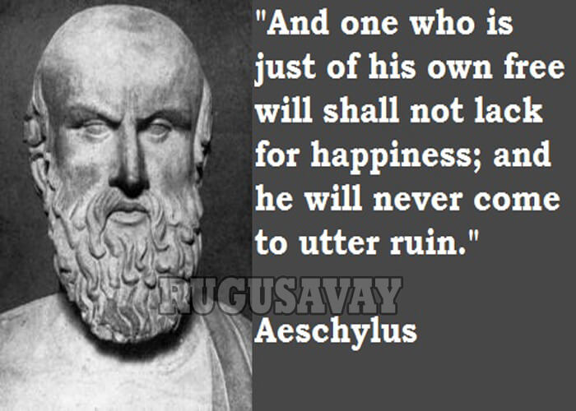
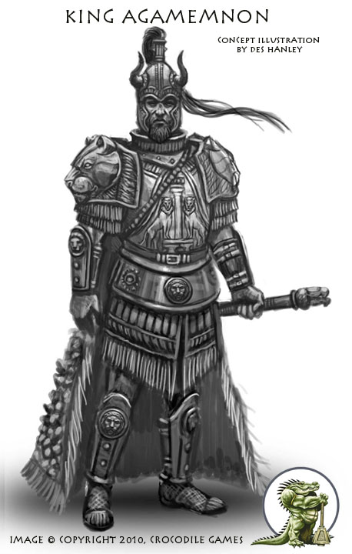
Aeschylus:
Aeschylus, the poet who best evokes Athenian power and grandeur, is deeply concerned with the moral issues that power and grandeur raise. He is widely known as the father of Greek drama, and was the first to write plays in trilogies.
He examines the dangers of overwhelming arrogance, the ancient rule of blood for blood, and the inevitability of the misuse of power. His conclusions are his own, often breaking with traditional concepts.
The most memorable of his plays are the three concerned with the story of Orestes, son of Agamemnon, the conquer of Troy.
The trilogy-Agamemnon, Suppliants and Eumenides-tells the story of Orestes’ murder of his mother, in revenge for her murder of his father.
He is said to have been killed when a tortoise was dropped on his head by an eagle that thought his bald head was a stone suitable for shattering the shell so he could eat it.

Slide 28
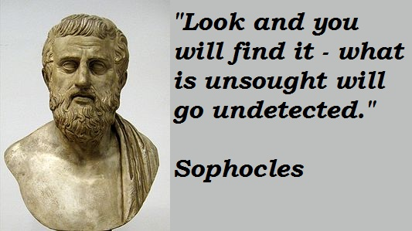
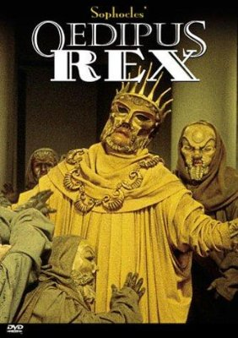
Sophocles:
Where Aeschylus argues for and justifies the ways of the gods, Sophocles is content to accepot them as they are, and treats them with awe and reverence. His characters are roundly human, but always noble.
Sophocles wrote 128 plays, only seven of which survive.
To Sophocles, any violation of the cosmic order creates suffering, but suffering can redeem and exalt. One of the best examples of this is his treatment of Oedipus in Oedipus Rex. Sophocles makes his a good-hearted but headstrong young man who kills his own father without knowing that he is his father, and marries his mother without knowing it is his mother. When he has discovered what he has done, he blinds himself in horror and remorse.

Slide 29
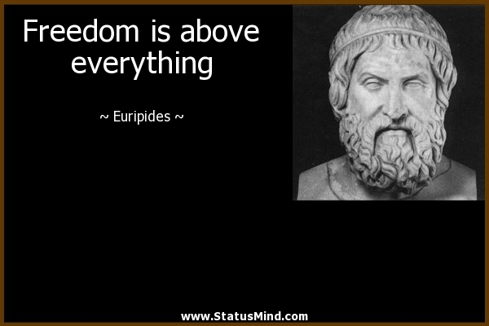
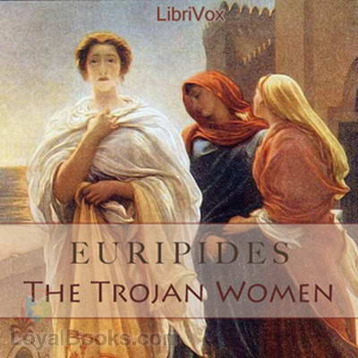
Euripides:
Euripides is a far more troubled, questioning and unsatisfied spirit, who has moments of astonishing insight into human character. Eighteen out of ninety plays survive, the highest ratio of all the Greek dramatists.
Euripides is also the most direct of the three in his questioning of established beliefs. Where Aeschylus and Sophocles merely suggest that the old ways may be wrong, Euripides criticizes them boldly.
Euripides was a recluse, retiring to Salamis to write, allegedly in a cave, and took almost no part in public life, unlike other playwrights. He married twice, each time unhappily, and bore four children.
Greek tragedy does not always end unhappily, but it is intensely and relentlessly serious. Even if there is a happy end, everything that precedes it is dark and anxious.
If Greek tragedy shows the Athenians’ depth of thought on the fundamental issues of life and death; Greek comedy shows their ability to face almost any situation with lightheartedness.

Slide 30


Aristophanes and Greek Comedy:
Where tragedy gave formal expression to the most awful kinds of human experience-disaster and death, comedy drew it’s ability to provoke laughter from incongruity and the unexpected.
Comedy involved satires and parodies of sexual union and erotic play, obscene jokes, grotesque masks, fantastic costumes, and provocative dance. Anyone seen Lysistrata?
The greatest of comedic Athenian playwrights was Aristophanes, who made fun equally of politicians, generals, philosophers, scientists, poets, and prominent citizens. He wrote 40 plays of which 11 survive.
Aristophanes situations are brilliantly absurd, and his characters, taken straight from life, burst with vitality.

Slide 31
Greek Philosophy and the Big Six
Naturalist Philosophy: The Pre-Socratics (before Socrates):
These philosophers reasoned that there must be a single, unifying substance that formed the basic “stuff” of nature. They asked, “What is everything made of?”, “How did we get here?”, and “What lies beyond?.”
Other views of the Pre-Socratics included the idea that the universe has no permanence, but is in a constant process or flux, as well as the idea that an underlying Form or Guiding Force permeated nature, an idea that resembles Hindu pantheism and anticipates the Christian concept.
Humanist Philosophy: The Sophists: “Those who make a business of being wise.”
These thinkers ushered in the field of inquiry known as metaphysics, the branch of philosophy concerned with abstract thought. They turned their attention from the world of nature to the realm of the mind, from physical matters to moral concerns, and from the gathering of information, to the cultivation of wisdom. From “What do we know?” to “How do we know what we know?”
The Sophists were concerned with defining the limits of human knowledge. They argued that truth and justice were relative: what is true and just for one individual, might not be just and true for another.

Slide 32


Pythagoras and Hippocrates
Pythagoras was a pre-Socratic thinker who advanced an idea that departed from both material and nonmaterial views of the universe. Pythagoras believed that proportion, discovered by number, was the true basis of reality. Stripping nature of supernatural associations, Pythagoras believed that all relationships may be expressed through numbers, the truths of which are universal and unchanging. His view that number gives harmony to the universe is basic to the principals of balance and proportion that dominate Classical art and music. He was an ascetic and a vegetarian, and he believed in reincarnation, which is why he became vegetarian.
Hippocrates was the most famous of the Greek physicians and labeled the “father of medicine.” Hippocrates studied the influence of diet and environment on general health, and advanced the idea that imbalance of bodily “humors,” was the cause of disease. Hippocrates is also considered the “father of medical ethics,” as even today graduating physicians are encouraged to practice according to the Hippocratic Oath, which binds them to heal the sick and abstain from unprofessional medical practices.

Slide 33


Socrates and the Quest for Virtue
Socrates believed that virtue was a condition of the psyche (soul/spirit/mind), hence, understanding the true meaning of virtue was foremost to acting virtuously. To know good is to do good.
Socrates insisted that the unexamined life was not worth living, and so to further his belief, he constantly challenged peers on matters of public and private virtue.
While on his pursuit, Socrates developed a tough question-and-answer technique known as the Socratic, or, dialectical method. This method consisted of probing a man’s beliefs and showing their inconsistency so as to reduce the victim to an admission of their own ignorance.
Socrates had no personal ambition, refused to take money for his teaching, and tried to order his own life along the simplest of lines, (possibly because he was independently wealthy, his father leaving him tons of money.)
Socrates won as many enemies as supporters, as the Greek people felt comfort in their gods and a retaliation against his methods of self-examination. He was accused of corrupting the young, and brought to trial, and after refusing to recant his ideas was sentenced to death and ordered to drink hemlock.

Slide 34


So you think that the gods know everything?
Yes, because they are gods.
“I know nothing except the fact of my ignorance.”
-Socrates
Do some gods disagree with others?
Yes, they do. They are always fighting.
So gods disagree about what is true and right?
Yes, I suppose they do.
So some gods can be wrong sometimes?
I suppose that is true.
THEREFORE THE GODS CANNOT KNOW EVERYTHING!!

Slide 35

Plato:
After studying under Socrates, Athens born aristocrat Plato opened the world’s first school of philosophy called the Academy. He taught his students how to live by a code of ethics that would lead them to live moral, happy lives.
Plato wrote some two dozen treatises, most in the dialogue that Socrates had made famous. Plato’s most famous treatise, the Republic, asks two central questions: “What is the meaning of justice?” and “What is the nature of a just society?” In these writings Plato set down his notions of what a state ought to be. He believed in government by a wise few, especially trained, an intellectual and moral elite.
These “philosopher-kings” would be educated until age 35-50, at which time they would be fit to govern the state. Plato argued that the philosopher’s job was to use reason to discover the Ideal Forms or Ideas, and that only the true philosopher can understand the exact nature of the world and the truth of moral values. Workers and soldiers rounded out Plato’s classes in a perfect, just society.
In trying to answer the question of the definition and meaning of a just society, Plato introduces a theory of knowledge that asserts the existence of a two level reality: one level consisting of unchanging eternal truths understood by way of intellect (Forms), and one level consisting of constantly changing aspects available to our senses (copies of Forms).

Slide 36
Plato’s Theory of Forms and Copies of Forms
The real world is the world of Ideals, which contains the Ideal Forms of everything.
The illusory world in which we live-the world of the senses-contains imperfect copies of the Ideal Forms.
We are born with the concepts of the Ideal Forms in our minds.
WE recognize things in the world, such as dogs, because we recognize they are imperfect copies of the concepts in our minds.
Everything in this world is a “Shadow” of its Ideal Forms in the world of Ideas.

Slide 37



Plato talks about the objects around us like beds, dogs, or triangles. When we see a dog, we know that it is a dog and we can recognize all dogs, even though they may differ in numerous ways. All dogs share the characteristic of “dogginess” which is something we can recognize and allows us to say we know what a dog is.
We all have in our minds an idea of an ideal bed or dog or triangle, which we use to recognize any particular instance. This leads to Plato’s use of reasoning within his theory. Plato believed that true knowledge came from reasoning or our minds, not from our senses. Within our minds exists the “true” nature of the world of Ideas or Forms, from the material world, or our senses, exists the copies of these Ideas or Forms.
To say it another way: for every earthly thing that we have the power to perceive with our senses, there is a corresponding “Form” or “Idea”—an eternal and perfect reality of that thing—in the world of Ideas.

Slide 38

Aristotle and the Life of Reason:
Aristotle was a student of Plato, however he did not accept Plato’s Theory of Forms, and after a period of travel, he founded a school known as the Lyceum.
In opposition to his teacher, Aristotle believed that the Real was not a reflection of ideal Forms, but existed in the objects of the material world. He equated Form with the true nature of a thing, and held that its full possession was achieved by the proper performance of its function, for example, the excellence of the eye lies in seeing well, and the excellence of a racehorse lies in how fast he runs.
Aristotle was essentially a biologist. In opposition to Plato, Aristotle accepted the senses as one of the most important sources of knowledge and the means for discovering the laws that govern the physical universe.
Aristotle developed a practice of basing conclusions on very careful observation advanced the empirical method, a method of inquiry dependent on direct experience. In the fields of biology, astronomy, and physics, Aristotle’s conclusions remained unchallenged for centuries.
Like Plato, Aristotle questioned the viability of the democratic state. Political privilege, he argued, was the logical consequence of the fact that some human beings were naturally superior to others in certain situations. From the day of their birth some were marked out for subjection, and others for rule.

Slide 39






The Greek Theater Experience:
The Theaters starting time was daybreak.
The theater was considered part of a Greek’s education and everyone was encouraged to come. The admission price would be refunded to playgoers who could not afford it, and they could asked to be reimbursed for the loss of a day’s wages.
In Athens during drama festivals all business was suspended, the law courts were closed and prisoners were released from jail. Even women, barred from most public events, were welcomed at the theater.

Slide 40
The Olympic Games:
Staged in honor of the gods, the Olympic games were held every four years at Olympia and drew athletes from all over Greece. They competed as individuals, not as teams, on a fervently amateur basis.
Not a town, but a grouping of temples, Olympia, during the games became a shanty town of sorts, with the spectators setting up tents and sleeping out in the open. The games were not simply a religious occasion, but also a fair, with vendors selling their wares, and leaders from surrounding cities discussing politics and and alliances, artists and poets entertaining, and a constant feast.
At the Olympic games spectators would see running and jumping, discus and javelin throwing events at the stadium, to the hippodrome to see horseback and chariot racing, and witness wrestling and boxing in front of Zeus’ alter.
Chariot racing and footraces were the essence of the Olympic Games. The opening spectacle was a four-horse chariot race, with as many as 40 chariots competing. The distance was nearly nine miles, of 12 double laps back and forth, resulting in many crashes as the horses skidded around stone posts. Very few finished the course.
Competition was fierce. Jockeys rode without saddles or stirrups, jumpers carries weights in their hands which they swung to gain more forward momentum, and wrestling included kicking and strangling to the finish, with biting, gouging and breaking fingers being the only actions outlawed. All wrestling and boxing was done in the nude. Greeks believed all exercising should be done in the nude as it fostered pride in physical fitness.
Winners at the Olympic Games received only olive leaf garlands. Lesser festivals gave more valuable prizes such as 100 vases of olive oil or cloaks. Statues were erected to winners in their home cities, and sometimes the home cities would give winners tax exemption.

Slide 41







Slide 42
Greek Dance:
Greek dance is said to come from the realm of the Nine Muses who were the daughters of Zeus, most specifically the muse Terpsichore, the sovereign of the dance.
Dance had a place in festivals, religious rituals, productions in the theater, entertainment at banquets, education of the young, and military training. Modern knowledge of ancient Greek dance comes mostly from paintings on vases, inscriptions carved on stone, and references in Greek and Latin writings.
Dancing commemorated the changing of the seasons, life and death, social solidarity, and the connection between humanity and the unseen powers that affected human existence.
The earliest description of a dance comes from Homer’s description of the shield of Achilles in the Iliad, on which the blacksmith Hephaestus portrayed two dance scenes. One is a dance of the grape harvesters as they pick the grapes for the vintage, and the other is a dance that specifically represents the historic civilization of the Minoans. Homer’s reference to dance in his epic poem indicate that the Greeks recognized the contribution dance had to ancient aesthetic.
Greek literature mentions many varieties of dance including the Pyrrhic dance, a war dance that imitated combat between warriors, the Herakeio dance, performed by women in honor of the goddess Hera, and the Hyporchema, a dance from Crete which combined pantomime and dance, performed by boys and girls who sang to musical accompaniment while they danced.

Slide 43






Slide 44




Making Connections:

Slide 45






Making Connections:

Slide 46







Making Connections:

Slide 47
Need To Know- Chapter 4
The Mycenaean were a tribal people, militant and aggressive, who established themselves in Greece in 1600 B.C.E.
Homer’s Iliad was a 16,000 line long epic story about Achilles and the Trojan War.
Greek city-states shared commonalities such as language, tradition and religion.
Greek comedy utilizes obscene jokes, grotesque masks, fantastic costumes, and provocative dance within its plays.
Socrates described the ethical life as belonging to a larger set of universal truths and an unchanging moral order. “To know good, is to do good.”
Philosopher Plato introduced a theory of knowledge that asserts the existence of a two-level reality called Forms and Copies of Forms.

